Slide 1

Numbers Prophecy
By Atharva Katre
https://www.numbersprophecy.ml

Slide 2

An online experiment to demonstrate the biases and predictability of our world.

Slide 3
Is anything truly RANDOM ?
We humans are often prone to thinking that our experiences in this world are nothing but a set of arbitrary choices with no specific underlining behaviour or patterns.
But researchers have found out that humans are quite predictable.
Studies have shown that our languages, information, technological advancements and even natural phenomena follow obscure patterns.

Slide 4
Study of Empirical Laws
An empirical law represents a type of behaviour that has been found across a number of datasets and, indeed, across a range of types of data sets.
What distinguishes an empirical statistical law from a formal statistical theorem is the way these patterns simply appear in natural distributions, without a prior theoretical reasoning about the data.

Slide 5
Laws used in this experiment
Benford's law
Zipf's law
Brevity law
Titius-Bode's law
Moore's law
Stigler's law of eponymy

Slide 6
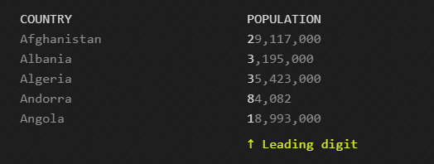
Benford’s Law
Imagine a large dataset, say something like a list of every country and its population.
Chances are, the leading digit will be a 1 more often than a 2. And 2s would probably occur more often than 3s, and so on.
This odd phenomenon is Benford's Law, also called the first digit law. If a set of values were truly random, each leading digit would appear about 11% of the time, but Benford's Law predicts a logarithmic distribution. This phenomenon occurs so regularly that it is even used in fraudulent accounting detection.

Slide 7
Benford’s law and why it’s important for Data Science?
Similar to the usage of Normal distribution as a tool for reference and gold standard, this law can be utilized to detect pattern (or lack thereof) in naturally occurring datasets. This can lead to important applications in data science such as catching anomalies or fraud detection.
Notable examples:
Benford’s Law was used to detect voter fraud in the 2009 Iranian election.
Ciaponia and Mandanici used the law in a research paper to investigate if Italian Universities intentionally used fraudulent data to bolster their books.
If you’ve watched the movie ”The Accountant” starring Ben Afflec, you can see him use Benford’s Law to uncover fraud.

Slide 8
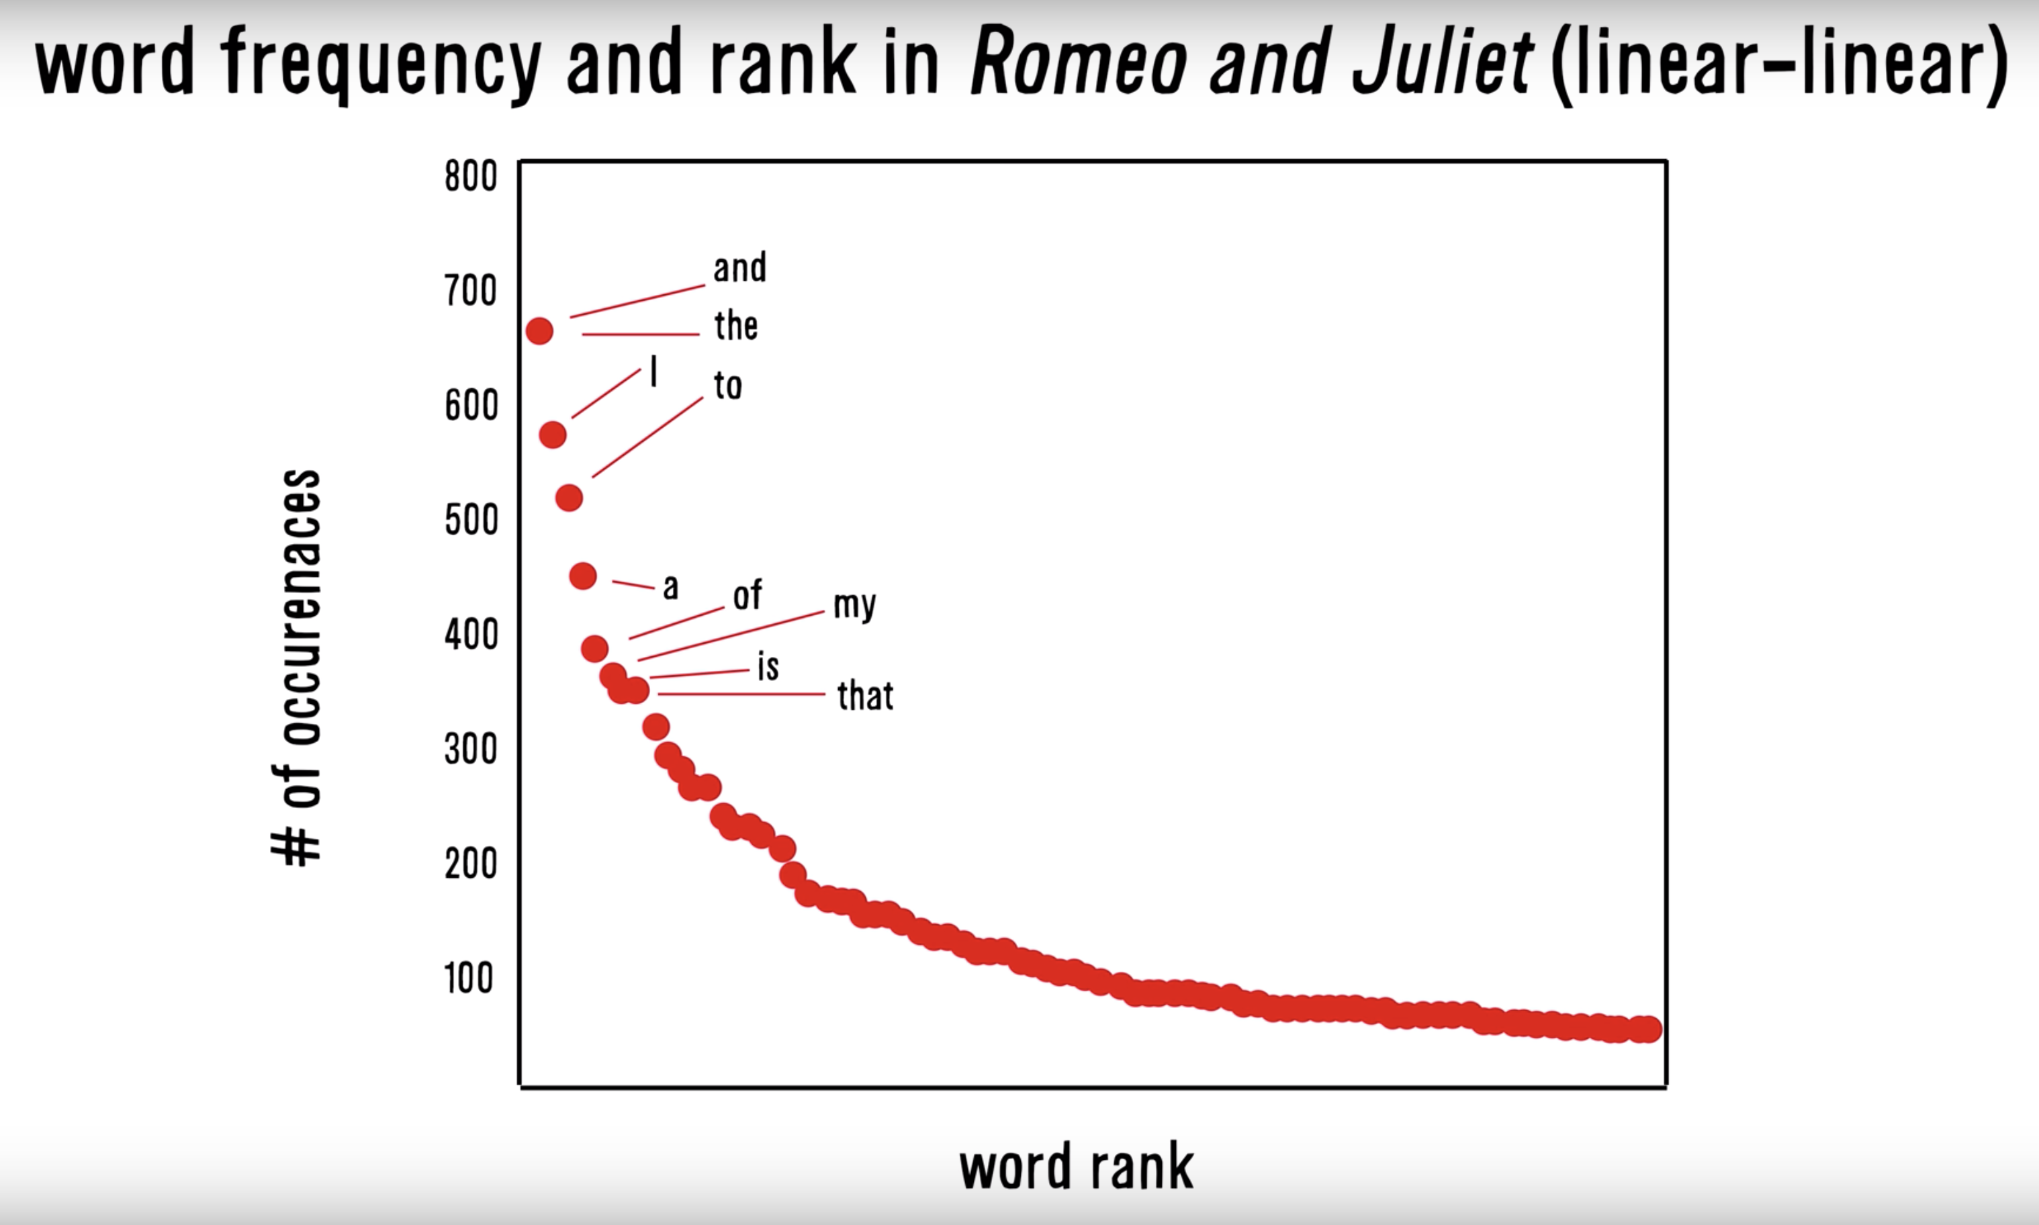
Zipf’s Law
This law examines the frequency of words in natural language and how the most common word occurs twice as often as the second most frequent word, thrice as often as the third most frequent word and so on until the least frequent word.
So the word in the position, n appears 1/n times as often as the most frequent one.

Slide 9
Zipf’s Law and real world applications
Zipf’s law is used in estimating fake social network accounts.
The Zipfian nature of distribution is sometimes used to normalize the importance of words in a search query, in an extension of ranking methods such as tf-idf.
With regard to Gene Expression, the fact that the abundance of expressed genes in a cell follows a Zipfian distribution -- and appears when the reactions lead to a successful cell reproduction -- allows the researcher to investigate universal properties of reaction dynamics and commonalities across many organisms.

Slide 10
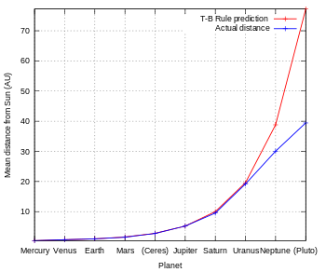

Titius-Bode Law
Sometimes termed just Bode's law is a formulaic prediction of spacing between planets in any given solar system. The formula suggests that, extending outward, each planet should be approximately twice as far from the Sun as the one before.

Slide 11
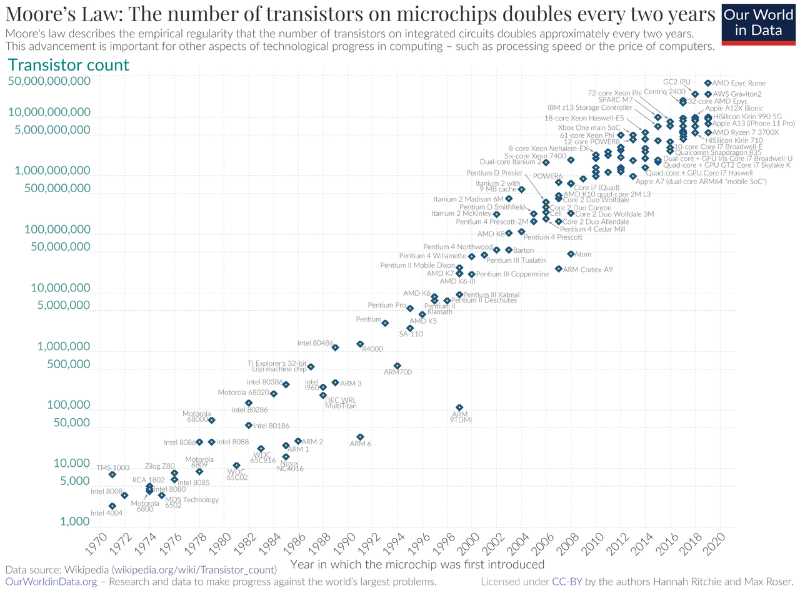
Moore’s Law
Moore's law is the observation that the number of transistors in a dense integrated circuit (IC) doubles about every two years. Moore's law is an observation and projection of a historical trend.
Moore's prediction has been used in the semiconductor industry to guide long-term planning and to set targets for research and development, thus functioning a bit like a self-fulfilling prophecy.

Slide 12
Datasets put to test (1/3)
Benford’s Law -
Total Area of Countries in Km²
Population of Countries
Runs scored by Batsmen in Test Cricket
Views count on Pornhub
Count of Covid-19 cases globally
Revenue generated by Movies in $US
People killed by Terrorism
Distance of Stars from Earth in light years
First 1000 Fibonacci numbers
Length of National Highways in India in km
Count of Global Infectious Diseases cases
Mass of Exoplanets in Earth mass
Depths of Earthquakes in km
Diameter of Moon craters in km
Deaths due to Natural Disasters
Damage suffered due to Natural Disasters in $US

Slide 13
Datasets put to test (2/3)
Zipf’s Law -
Brevity Law -
Most Common Words in the English Language
Most Common Words in the Marathi Language
Most Common Words in the English Bible (King James Version)
Random books from the Gutenberg Project
Most Common Surnames in the US
Top cities by Area size
Victim’s Age in Dog Attacks (up to 10 years old)
Most Common Words in the English Language
Titius-Bode Law -
Distance of Planets from the Sun

Slide 14
Datasets put to test (3/3)
Moore’s Law -
Count of MOS Transistors in Microprocessors
Count of MOS Transistors in GPU
Count of MOS Transistors in RAM
Count of MOS Transistors in Flash Memory

Slide 15






Languages/ Libraries used

Slide 16
Thank You
Visit https://www.numbersprophecy.ml/ to check out the project.

